Slide 1
Week 5 Q&A
2024.03.28 簡廷因

Slide 2
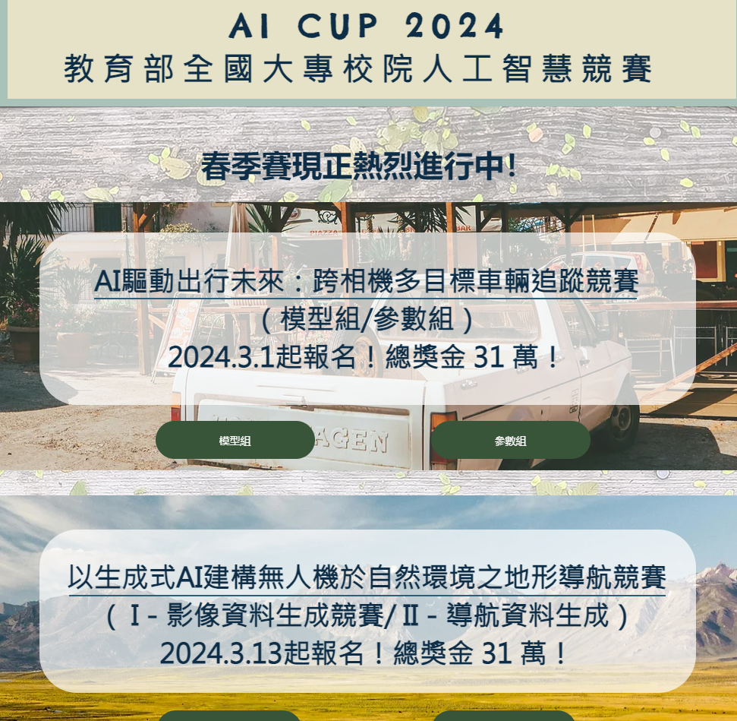
FYI
2024 AI CUP
https://www.aicup.tw/%E5%89%AF%E6%9C%AC-ai-cup-2023

Slide 3
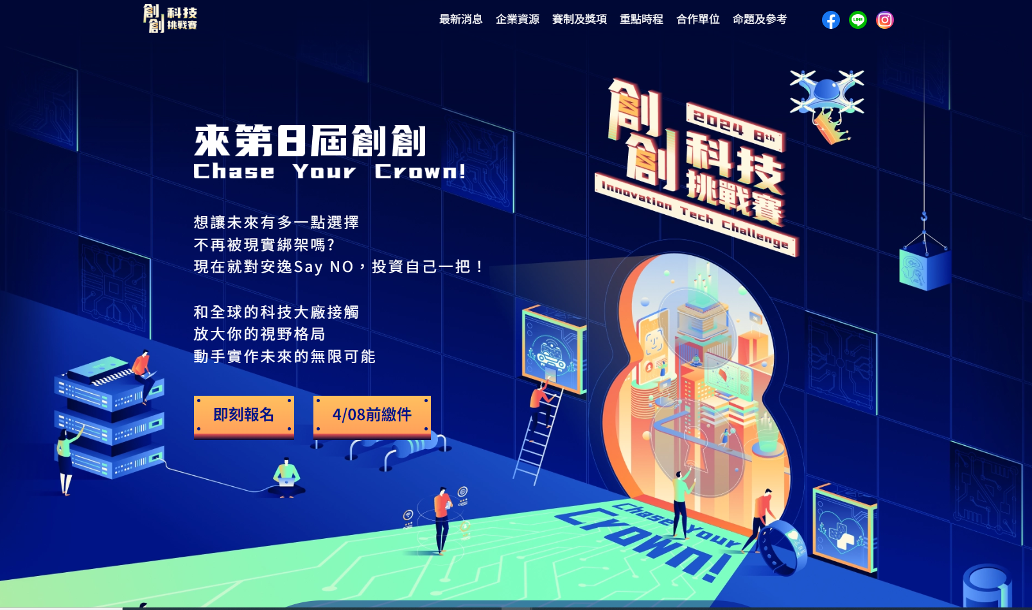
FYI
創創科技挑戰賽
https://innovatech.istumate.com/

Slide 4
schedule
04/25 | Rshiny (Data Visualization)
05/02 | Data mining
05/09 13:00 ~17:00 | Final project proposal (PPT + Oral Presentation)
05/16 | adjust to 05/09, 05/23 and 05/30
05/23 13:00 ~17:00 | Data mining
05/30 13:00 ~17:00 | Machine learning / Deep learning
06/06 | Machine learning / Deep learning
06/13 | Text Mining
06/20 | Final project demo (PPT + Oral Presentation)

Slide 5
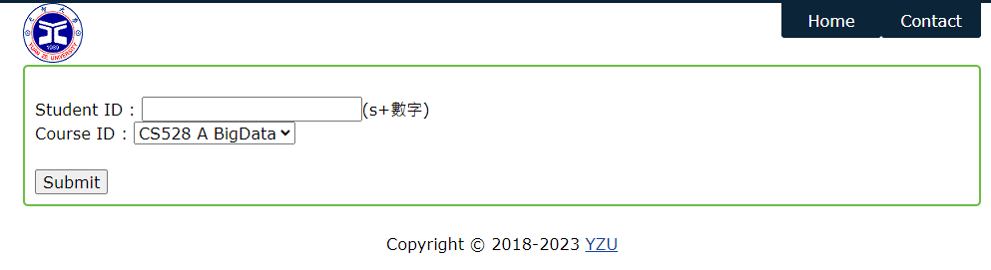
Sign in
http://dslab.csie.org/bigdata/

